Slide 1
Transportation Asset Management Webinar Series Webinar 6: Addressing Preservation and Maintenance in Asset Management Plans Sponsored by FHWA and AASHTO Press F5 to enter full screen mode, press Esc to exit full screen mode. Please do not put your phone on hold.
Webinar 6 — September 18, 2013
Notes:
Please do not put your phone on hold.
Please mute your phone.
If you do not have a mute button on your phone, press *6 on your phone keypad.
Press F5 to go to full screen mode, press Esc to go out of it

Slide 2
FHWA-AASHTO Asset Management Webinar Series
Sharing of knowledge is a critical component of advancing asset management practice
This is the sixth of a 12-part webinar series that will run over a two year period
Webinars will be held every two months with topics such as AM and performance-based planning, AM data needs, etc.
Welcome ideas for future webinar topics and presentations
Submit questions using the webinar’s Q&A feature
Next webinar: Asset Management and Adaptation to Climate Change and Extreme Weather Events – November 13, 2013 2:00 EST

Slide 3
Welcome
FHWA is pleased to sponsor this webinar on preservation and maintenance in asset management plans, in cooperation with the AASHTO Sub-Committee on Asset Management
Today’s presentations are from the TAM peer exchange on maintenance and asset management that was held in Burlington, Vermont on July 24th and 25th this year
The peer exchange was part of the AASHTO Subcommittee on Maintenance and Subcommittee on Asset Management joint meeting
Notes:
Steve

Slide 4
Asset Preservation and Maintenance in Asset Management – Overview
Maintenance is a crucial activity that maximizes the value of transportation investments, and ensures the continued performance of a DOT’s assets.
There are often issues between different groups in transportation agencies regarding how to define terms such as “maintenance” and “preservation.”
As an industry, we need to have better information on how well different preservation treatments perform.
Notes:
Steve

Slide 5
Asset Preservation and Maintenance in Asset Management – Overview
States will need to develop risk-based TAMPs in compliance with MAP-21.
MAP-21’s definition of asset management emphasizes the importance of preservation:
“Asset management is a strategic and systematic process of operating, maintaining, and improving physical assets, with a focus on engineering and economic analysis based upon quality information, to identify a structured sequence of maintenance, preservation, repair, rehabilitation, and replacement actions that will achieve and sustain a desired state of good repair over the lifecycle of the assets at minimum practicable cost.”
FHWA has an ongoing project to work with a selected set of states to pilot development of TAMPs. We will hear from one of the pilot states today.
Notes:
Steve

Slide 6
Webinar Overview
Today’s presentation includes three perspectives on how states are integrating maintenance into their AM programs.
Presenters will discuss their agencies’ efforts in building their TAMP and integrating maintenance condition assessments into the AM decision-making cycle.
Presentations will address specific challenges, success factors, and key benefits obtained and will highlight successful approaches for strengthening the relationship between maintenance, TAMPs, and results-driven decision-making.
Together, we will explore the benefits that State DOTs are achieving by more closely aligning maintenance and AM programs.

Slide 7
Learning Objectives
Building working knowledge of key concepts and definitions in the areas of preservation, maintenance, asset management programs, and the transportation asset management plans
Understanding specific approaches being used to develop a MAP-21 transportation asset management plan
Applying this knowledge to begin to answer the following questions:
How are maintenance and asset management integrated?
How is maintenance being addressed in TAMPs?
SHARE LESSONS LEARNED, IDEAS, KNOWLEDGE!!!

Slide 8
Webinar Agenda
2:00 Webinar introduction and overview Matt Hardy (AASHTO), Steve Gaj (FHWA), and Hyun-A Park (Spy Pond Partners, LLC)
2:15 Louisiana DOTD TAMP Project
Vince Latino (Louisiana DOTD)
Jason Chapman (Louisiana DOTD)
2:35 Integrating Maintenance and Asset Management
Jennifer Brandenburg (North Carolina DOT)
2:55 Using Maintenance Expertise in the Transportation
Asset Management Plan
Martin Kidner (Wyoming DOT)
3:15 Q&A and wrap up

Slide 9
LOUISIANA DOTD
TAMP PROJECT
Vince Latino, P.E.
Jason Chapman, P.E.

Slide 10
OVERVIEW
LA DOTD’s TAMP Status
LA DOTD’s Existing Data
Current TAMP Tasks
Significant Challenges

Slide 11
TAMP STATUS
Created a TAM Steering committee in 2011
Mr. Michael Bridges serves as Executive Champion
Appointed Chief Maintenance Engineer and Data and Systems Director as Co-Leads
Conducted NHI TAM course with Executive Staff and TAM Committee
Asked to be part of FHWA 3 State Pilot
Conducted 1st meeting with FHWA TAMP Consultant during 1st Quarter 2013.

Slide 12
TAMP STATUS (cont)
Consultant produced Work Plan
LA DOTD assigned tasks to data and process owners
Scheduling more face to face meeting with FHWA TAMP Consultant
Target completion of final draft by end of this calendar year

Slide 13
LA DOTD’s EXISTING DATA
LA DOTD has been doing Asset Management but have not developed a formal plan
Pavement Management
Bridge Management
LA DOTD has performance measures and targets for road and bridge
LA DOTD has many plans already in existence
Implemented Agile Assets (Asset Management System)
Starting to include other assets into Agile

Slide 14
CURRENT TAMP TASKS
Working Plan
LA DOTD’s Task List

Slide 15
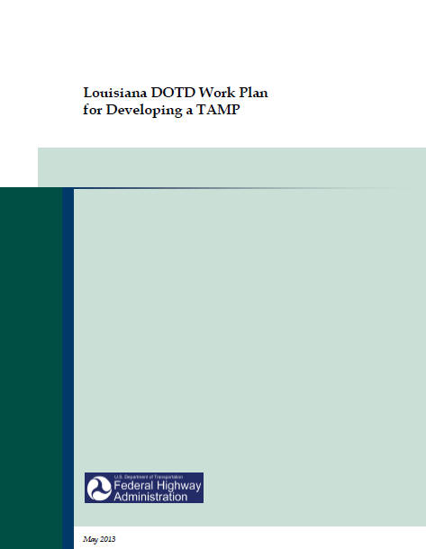
FHWA Work Plan Document

Slide 16
TAMP Task Chart
Task # | Task Description | Assigned To | Due Date | Status
1 | Develop templates for summarizing pavement and bridge inventory and condition data | Chris F. - Pavement Scott C. - Bridge | 9/26/2013 | Concept of the templetes is very close to information already reported.
2 | Compile data needed to propulate the templetes | Chris F. - Pavement Scott C. - Bridge | 9/26/2013 | Most of the informatin is already available and they are working on compiling
3 | Identify roadway segments that have recently been added to the NHS, compare against prior NHS, and summarize the gaps | Darrell M. and Jamie S. (FHWA) | 9/26/2013 | They are working on the final list, and hopefully have by end of June.
4 | Compile and synthesis existing materials in LA DOTD's Strategic Plan, Long Range Plan, pavement and bridge management systems, dashboards and internal performance scorecards | Dan B. - 30 year plan Chris F. and Scott C. - pavement and bridge Wade L. - Strategic plan, dash boards and score cards | 6/27/2013 | Plans exist and we are going to compile these documents
5 | Document the performance measures that will be used throughout the asset management planning session | Wade L. | 6/27/2013 | The measures exist need to compile
6 | Develop and implement an approach for presenting capacity, condition and maintenance LOS | Hong Z. - capacity Jason C. and Vince L. - Maint. LOS | Approach for - 6/27/2013 Complete - 9/26/2013
7 | Document the process for developing pavement and bridge conditon LOS and establishing measures | Chris F. - Pavement Scott C. - Bridge | 9/26/2013
8 | Coordinate with LA DOTD's ongoing budgeting process | Don B. and Robin R. | Approach for - 6/27/2013 Complete - 12/15/2013
9 | Develop and implement a process for analyzing future bridge conditions | Scott C. | Approach for - 6/27/2013 Complete - 9/26/2013 | In process
10 | Develop and approach for considering non-condition related needs into the performance gap analysis | Robin R. | Approach for - 6/27/2013 Complete - 9/26/2013
11 | Document the performance gap process | Mr. Bridges, Jason C., and Vince L. | 9/26/2013
12 | Summarize the importance of considering lifecycle costs, and describe how bridges and pavement are managed throughout their whole life | Chris F. - Pavement Scott C. - Bridge | 7/25/2013
13 | Document how lifecylce costs are addressed by LA DOTD's pavement mangement system | Chris F. | 7/25/2013
14 | Update and document the process for incorporating lifecycle costs into district-level decision making | Chris F. - Pavement Scott C. - Bridge | 7/25/2013
15 | Develop lifecycle cost estimates for adding a new lane mile of pavement | Chris F. - capital costs Vince L. - operating costs | 7/25/2013
16 | Develop an approach for incorporating this lifecycle cost information when evaluating and prioritizing highway expansion projects | Chris F. - capital costs Vince L. - operating costs | 7/25/2013
17 | Develop an initial risk register | Jason C. and Vince L. | Approach for - 7/25/2013 Complete - 10/24/2013 | Held first meeting to identify agency level risks
18 | Identify the highest risk bridges in the State | David M. | Approach for - 7/25/2013 Complete - 10/24/2013 | Believe this already exists
19 | Document the process used for the risk analysis | Jason C. and Vince L. | 10/24/2013
20 | Compile hstoric funding levels for NHS pavement and bridges | Robin R. | Approach for - 7/25/2013 Complete - 11/15/2013
21 | Compile existing information on future revenue projections | Dan B. and consultant for 30 year plan | Approach for - 7/25/2013 Complete - 11/15/2013 | Believe we can use what is being developed for 30 year plan
22 | Summarize the program funding levels resulting from the ongoing budgeting process | Dan B. | Approach for - 7/25/2013 Complete - 11/15/2013
23 | Develop and implement an approach for assessing the financial sustainability of the transportation system | Mr. Bridges | Approach for - 7/25/2013 Complete - 11/15/2013
24 | Document the process used to develop the financial plan | Don B. and Robin R. | 11/15/2013
25 | Define investment strategies | Steering Committee | 11/15/2013
26 | Document the process used to define investment strategies | Steering Committee | 11/15/2013
27 | Conduct the asset management self-assessment exercise | Mr. Bridges and IT (Steering Committee will take the assessment | 10/24/2013 | Will use survey monkey
28 | Conduct the gap analysis process, described in the AASHTO Asset Management Guide | Mr. Bridges, Jason C., and Vince L. | 10/24/2013
29 | Throughout the TAMP development process, identify opportunities for process, system and data enhancements | Steering Committee | 10/24/2013 | Keep a list
30 | Determine which assets should be addressed in future asset management planning cycles, and identify implementation activities | Steering Committee (Vince L.) | 10/24/2013 | Held a working group meeting to outline the assets. Then will bring to the committee to prioritize
31 | Combine the results fo activities #28 through #31 into na asset management improvement plan | Steering Committee | 10/24/2013
32 | Document the process used to develop the asset management enhancement plan | Steering Committee | 10/24/2013
33 | Develop and document a TAMP governance process | Mr. Bridges, Jason C., and Vince L. | 10/24/2013

Slide 17
Agency Risk Register
Risk Description | Key Risk Area | Potential Cause | Existing Risk Controls, management actions and management tools | Risk Assesment with existing controls
 |  |  |  | Consequence | Likelihood | Risk Rating
Negative public opinion | Reputation | loss of buying power (funding), trust, fraud, incident (bridge failure), poor employee customer service, system deterioration, | Public relations, executive management, performance, | Moderate | Possible | Medium
lack of operating funding | Financial | inflation, flat revenue stream, negative economic conditions, other budget demands, alternative fuels/fuel efficiency, | education of elected officials, stategic thinking, continuous improvement/efficiency, eleminate services, reduce staffing | Major | Almost Certain | Critical
cut in federal funding | Financial | federal highway trust fund insolvency | alternate priority program, statewide longrange plan, sell GARVEE bonds | Major | Possible | High
insufficient match for federal funds | Financial | increase in fed funds, decrease in state funds, increase shift to other parts of state budget, increased operating costs, disaster, federal legislation, change in match ratio, | restructure state highway program, cut port and flood control programs, cut parish trans fund, cut operating budget, use toll credits as match, apply for GO bonds, apply for state general funds, reduce level of service | Major | Likely | High
loss of staff | Business Performance and Quality | continual downsizing, aging population, reduced benefits for workers, funding, emphasis on privatization | succession planning, recruiting, overhire, cross training, workforce development program, structured training, outsourcing | Major | Almost Certain | Critical
weather events due to environmental changes | environmental | climate change, hurricane, subsidence, sea level rise, coastal erosion, flood events, drought, | design standards, emergency prepardeness, support for levee districts, flood control program, infrastructure hardening, improved data (elevations), disaster recovery plan (COOP), | Moderate | Almost Certain | High
terrorist/criminal acts | security | terrorism, criminal activity, | rest area security, cameras, fund weight enforcement and traffic control, access to as-built plans, building security, pre-employment drug screen, critical safety positions random screening, | Catastrophic | Rare | Low
structure failure | safety | permit violators, ineffective weight enforcement, terrorism, lack of funding, negligence, | fund weight enforcement, issue permits, focus on infrastructure preservation, inspections, solicit funding, building security, | Major | Possible | High
workforce safety (sudden loss of workspace or staff) | safety | workzone accidents, pandemic, workplace violence (pandemic, evacuation event, weather event) | disaster recovery plan (COOP), public education, structured training, cpr/first aid training, building security, workzone tech inovations | Minor | Almost Certain | Medium
adverse legisative actions to priority programs | Stakeholder Management | uninformed elected officials, parochialism, short term thinking, worst first, NIMBY, desire to add projects not in program | transparent project selection process, strong legislative controls, active liason efforts, education/outreach | Major | Possible | High
changes in regulatory policy | Financial and Legal/Compliance | wetlands mitigation, air quality regulation, noise regulation, additional NEPA requirements, ADA requirements, wage rate requirements, buy America provision, debris management, DBE (disadvantaged), SBA (small business), | early recognition of requirements (stage 0), impact avoidence, training | Moderate | Possible | Medium
continuity of operations | Business Performance | hazmat, pandemic, natural disaster, other manmade disaster, terrorism, | COOP, | Major | Rare | Low

Slide 18
CHALLENGES
Risk Register
Financial Plan and Investment Strategies
Lifecycle Costs
Understanding how the TAMP fits into the Department’s Policies and Plans

Slide 19
Integrating Maintenance and Asset Management
Jennifer Brandenburg, PE
State Asset Management Engineer

Slide 20
Discussion Points
Conducting The Assessment
Reporting The Data
Planning The Work
Reporting The Results
Gaining Perspective

Slide 21
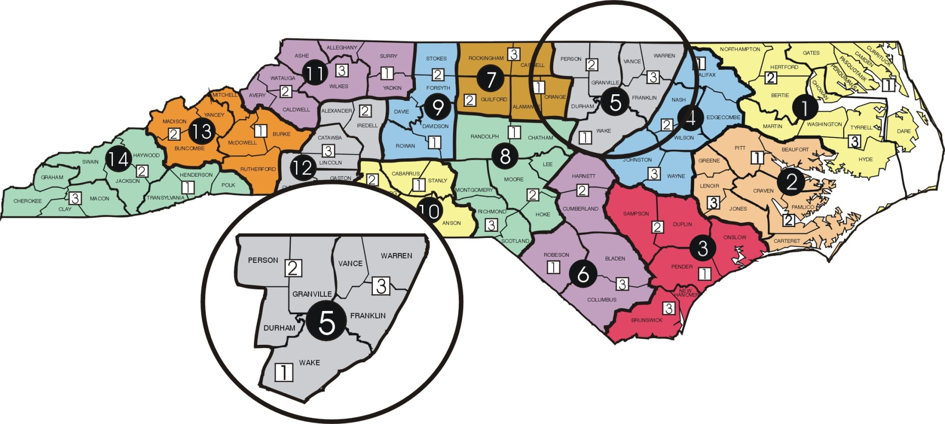
NCDOT Organization
Notes:
For perspective about NCDOT these are some statistics
79,327 road miles
170,958 paved lane miles
18,303 structures
91.8 M sf bridge deck area
4,495 miles of unpaved roads (Which I will come back to later)
14 highway divisions, 40 maintenance districts report to the divisions

Slide 22
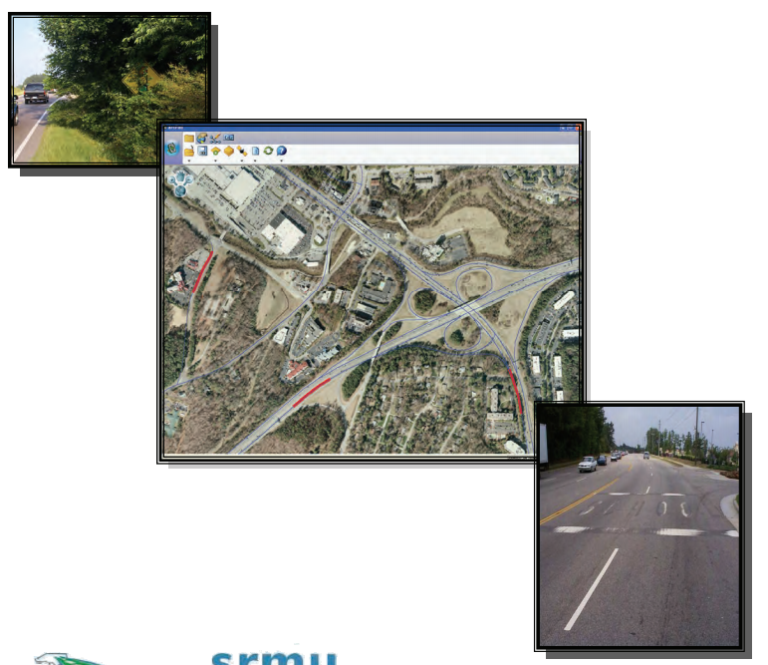
NCDOT Assessments
Notes:
Our MQA process is made up of several different condition surveys
We assess up to 18 different attributes depending on the system
Random sampling covers most
Sampling is conducted over a 12 month period using internal and consultant forces
Sample all three systems: Interstate, Primary and Secondary
Conduct about 23K samples annually
Do 100% surveys on Pavements and Bridges
Assessment program not only provides feedback to the Department but drives maintenance operations

Slide 23
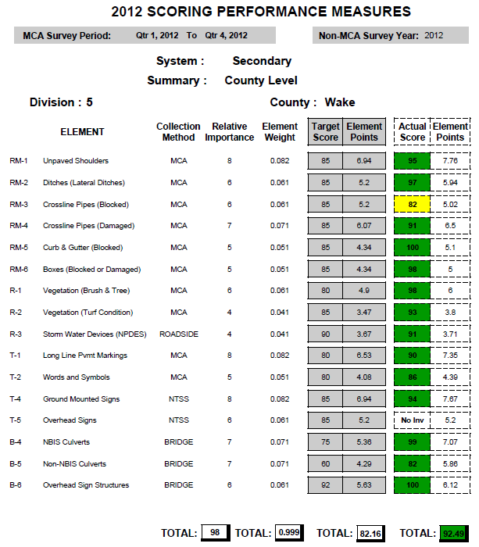
Reporting The Data (Scorecards)
Statewide for all three systems
Division level for interstate
County level for primary and secondary
Produced by the maintenance management system
Notes:
We put our assessment data into our AMS and calculate scorecards for:
Statewide for all three systems
Division level for interstate
County level for primary and secondary
Produced by the maintenance management system
Describe scorecards
Element Description
Collection method is the various surveys
Target Score
Element weight indicates level of importance
Actual scores
Colors
Red - More than 10 points below target
Yellow - within 10 points below target
Green – meets or exceeds target
Target total vs. actual total
All that green can be misleading and many have misinterpreted the results
Have to look at other features such as pavements and bridges to get the overall picture
Created Infrastructure Health Index to help bridge the gap

Slide 24
Reporting The Data (Infrastructure Health Index)
STATEWIDE – ALL SYSTEMS
EXISTING INFRASTRUCTURE HEALTH WEIGHTED BY VMT (80% AND LM (20%)
Notes:
IHI does:
Combines Roadway (MCA), Pavement (PCR), and Bridge (BHI)
Provides a system and overall network ratings
Statewide and Division level
Produced by the maintenance management system (future)
Looking vertical, there is a combined score by asset by system
Looking horizontally, there is a combined score for a particular system.
We apply weighting factors for:
LMS
VMT
Feature importance
40% Pavement
25% Maintenance (Roadside Features)
35% Bridge
Overall Asset Score – Bottom right. Combines systems and assets

Slide 25
Planning The Work
Determine areas of deficiency
Determine work functions needed and develop work plan
Report outputs
Outcomes/Outputs are part of employee performance evaluation
Notification of critical maintenance needs
Notes:
All departments are accountable for meeting targets.
How do we get there, What is the best mix of activities to perform to achieve the highest LOS
I have all this data!
Next steps…..
Outcomes some managers appraisals such as LOS or Crash Rates
Outputs on workers appraisals such as shoulder miles of ditches maintained or square yards of chip seals places

Slide 26
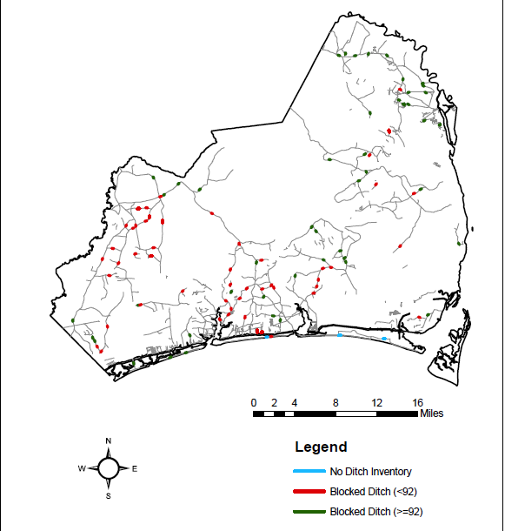
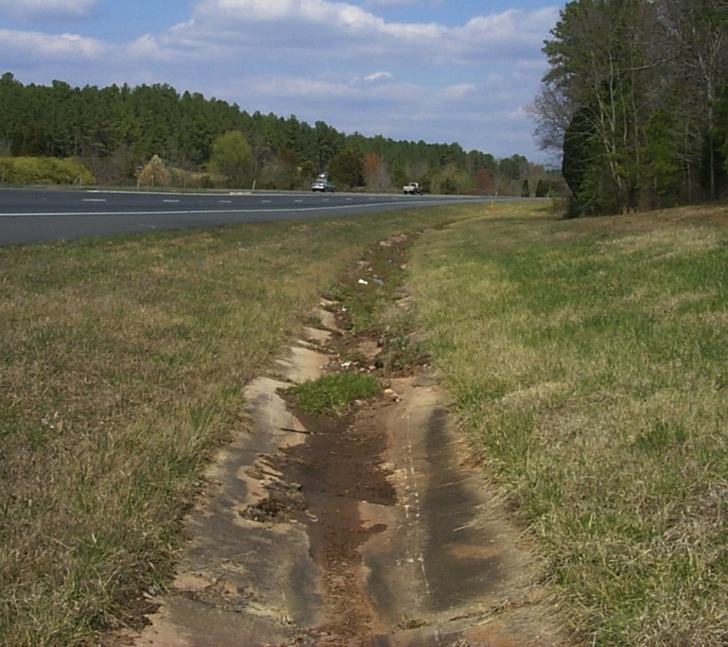
Planning The Work
Notes:
One approach to planning is to use GIS tools to display data
Notice the cluster of Blocked Ditch in the South West portion of Brunswick County.
North East corner meets or exceeds the target
By showing this data on a map it is easy to determine where work needs to be performed to make the biggest overall impact

Slide 27
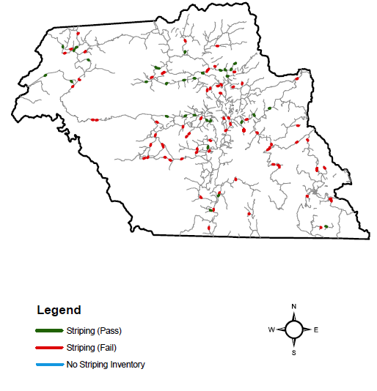
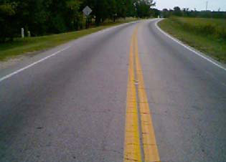
Planning The Work
Notes:
Another example of a GIS map for striping
No specific area that needs attention. Wide spread failures, but some clustering around the central part of the county

Slide 28
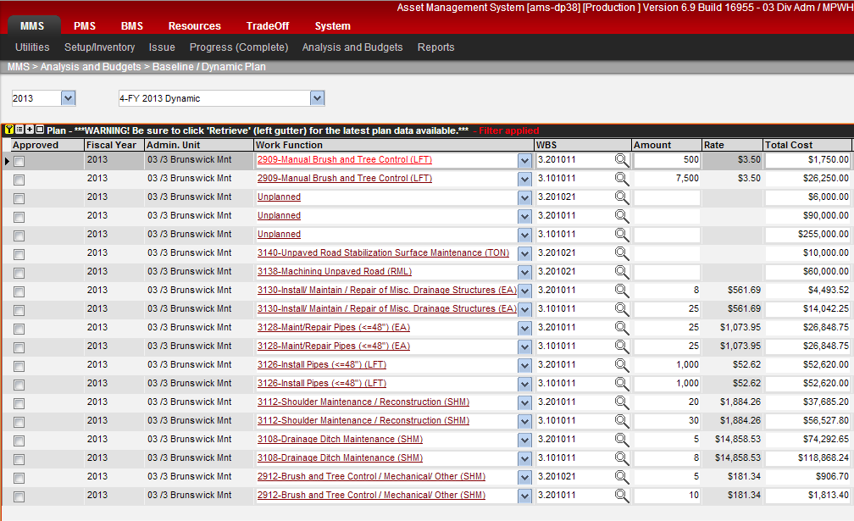
Planning The Work
Notes:
Once we determine what is deficient, we plan our work activities and the amount of work needed
These plans are developed in MMS
Data is entered at the activity level per system
Dollars or Work Quantities can be planned – Either can be entered and the other will be calculated based on unit costs.
Such as 3112 Shoulder maintenance or 3108 Ditch maintenance
Amount is the work accomplished (Each, Shoulder Mile, Linear Feet, etc.)
We are in the process of further developing the software to allows a user to run an analysis that will provide an optimal LOS based on available funding.

Slide 29
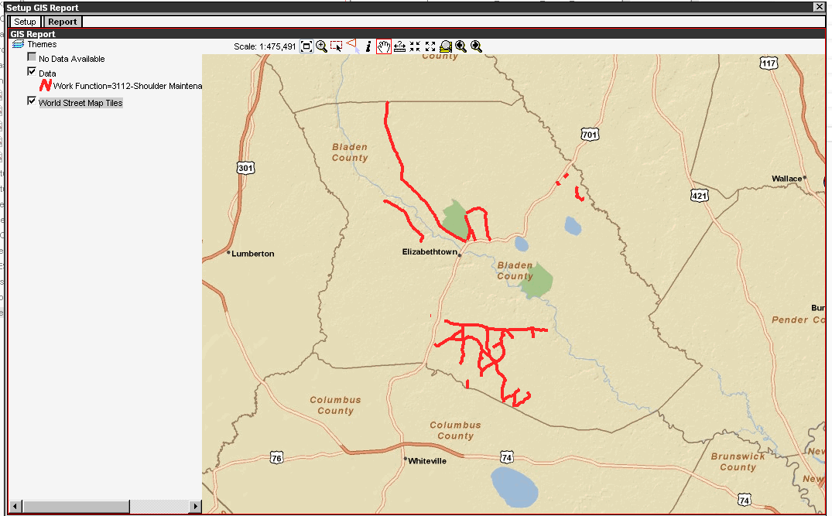
Planning The Work
Notes:
A graphical approach to planning is to show the roads where work is planned to allow others to avoid conflicting operations. We have all cringed at the pipe replacement that immediately follows the asphalt overlay. These maps help prevent those types of conflicts.

Slide 30
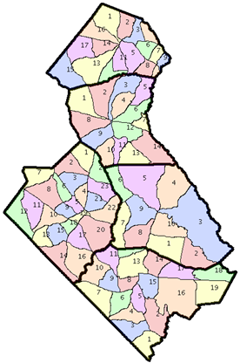
Sectional Planning
Alternate Planning Process
Allows for cyclic approach
Improves Coordination Among Work Groups
Notes:
There are 2 schools of thought on planning:
Outcome based
Life cycle based
Both have merits
In NC we use both. One division uses outcome based while this division uses a sectional based planning intended to replicate lifecycle based planning
It does focus all work activities and improves coordination
While ditch operations are in section 1this year
Spraying operations may be in section 2 and so on

Slide 31
Reporting The Outputs
Notes:
So now we have studied our conditions, planned our work now it is time to work.
Work accomplished is entered into our maintenance management system and the management system provides numerous reports to help track and manage maintenance plans
This report compares Plans to Actuals
We also have the ability to map this data so you can see where you have worked

Slide 32
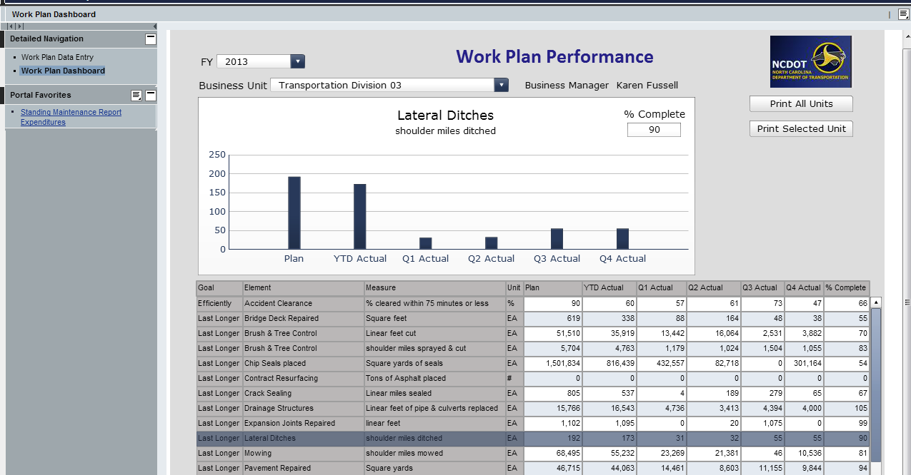
Reporting The Outputs
Notes:
The MMS plan that we just discussed feeds an internal dashboard where division personnel as well as upper management can see their work accomplished as compared to the plan.
Individual plans are compared against Department goals quarterly

Slide 33
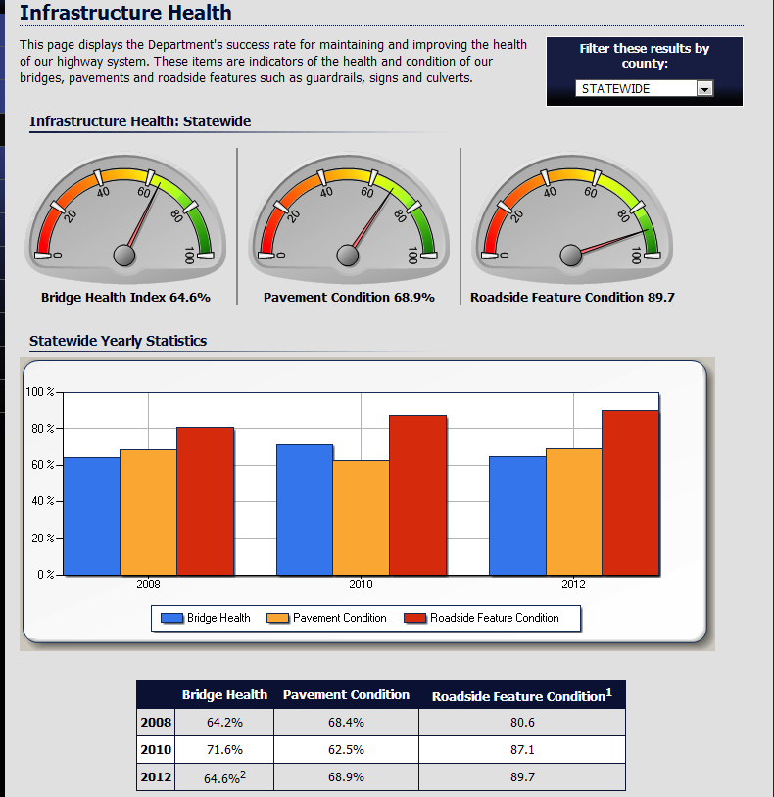
Reporting Outcomes
Notes:
The last two slides were methods of reporting outputs. These outputs translate into outcomes
The outcomes from the Division work plans directly contribute to the overall organizational score.
These scores are displayed on the external dashboards
The public can see the data for statewide or their county
They can see historical trends, etc
They can not drill this data down to their individual road

Slide 34
Reporting Outcomes
Notes:
And bringing us full circle these outcomes are also reported internally in the form of our scorecards following the next assessment.

Slide 35
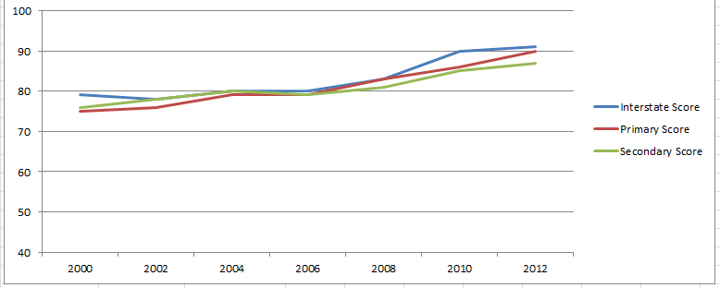
Looking Back
Performance Measure Trends
Roadside Features
Notes:
The adage of :what gets measured gets managed” applies to our infrastructure activities as well. You can see our scores on all systems have trended upward since we started measuring in 1998.
We are starting to see significant progress toward meeting our targets on these roadside features. At this point we start to consider things like, are my targets to low? Do I need stretch goals? What do my other assets looks like? Do I need to adjust funding levels across assets?

Slide 36
Looking Back
Performance Measure Trends
Bridge Health Condition
Notes:
As you can see our bridge health is certainly not as good as our roadside features. With a target of 75%, you will see our scores are below that.
Again I can break out the data by system, by county, etc.
The projected bump at the end indicates the impact of a new funding initiative our legislature made to try and improve bridge conditions.
Talk about change in system preservation funding.

Slide 37
Looking Back
Performance Measure Trends
Overall Pavement Condition
Notes:
And this is the overall pavement condition trend. You can see we are below target here as well.
We have a percent good target of 80% and currently out percent good is at 70%
We have been able to use our management systems to show the legislature that by funneling all the preservation money to bridges we expect our pavement conditions to drop.

Slide 38
Looking Ahead
Strategic Mobility Formula
Just signed into Law last week
Redirects trust fund dollars from paving unpaved roads
Accelerates capitol projects
Encourages economic growth
Data driven process
System Preservation Funds
Notes:
What’s ahead for NCDOT?
We are attacking our maintenance needs on two fronts.
STRATEGIC MOBILITY FUND
I told you we have a trust fund which was designed to pave unpaved roads. We are to a point in our state where in most cases it really doesn’t make financial sense to pave the ones that are left.
The Strategic mobility formula passed just last week, changes the funding formula for those trust fund dollars.
It is designed to accelerate capitol projects and encourage economic growth
It is a data driven process using a formula that accounts for condition, ADT, population, etc.
SYSTEM PRESERVATION FUNDS
And lastly, we continue to work with our legislature to develop a balanced approach to the use of our system preservation funds.
Improving our bridge conditions is certainly a worthy endeavor, but at what cost?
We have worked for the ability to use a more data driven approach on the divisions of these funds as well.

Slide 39
Questions?
Notes:
And as you ponder what questions you have for me I will tell you that the ladies went on an asset management tour the other night and we found the Ice House Restaurant to have a great Level of Service and value for the money invested.

Slide 40
Using Maintenance Expertise in the Transportation Asset Management Plan
Martin Kidner
State Planning Engineer
Wyoming DOT
martin.kidner@wyo.gov

Slide 41
Silos are Good
Experts putting together expert systems that bring the power of that knowledge to bear.
Notes:
The subtitle of the presentation tries to get at the point that for asset management to work, the idea of properly managing our assets becomes a way of doing business. Maintenance, Traffic, Pavement, Geology, all have to be involved.

Slide 42
Highway Asset Management Plan
Plan Contents
Pavement and bridge inventory and conditions on the NHS,
Objectives and measures,
Performance gap identification,
Lifecycle cost and risk management analysis,
A financial plan, and
Investment strategies
Notes:
These contents are what is required in the TAMP by MAP-21. One of Maintenance’s biggest contribution is the life cycle cost of the work to keep the roads in the condition they are in.

Slide 43
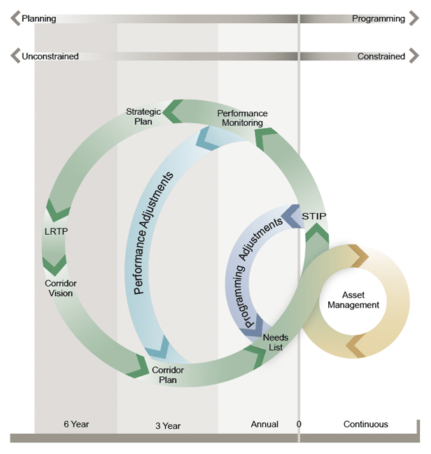
Planning Cycle
Notes:
Wyoming uses this nested circle diagram to show that all management decisions we make are cyclic. How do our decisions effect the corridor? Does our budget support our performance goals, or do we have to adjust our goals? Are the right projects being selected to support our goals and being checked with the asset management silos of excellence? It isn’t linear.

Slide 44
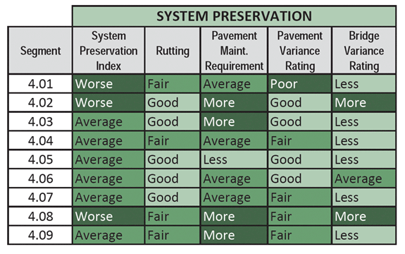
System Preservation
Notes:
Wyoming uses a corridor system to see if the road between network nodes is performing correctly. For example, from Rock Springs to Jackson in Wyoming how does the pavement and bridge perform.

Slide 45
Additional $134.5 M for Bridge/Pavement
Notes:
This corridor approach helped us four years ago come up with an estimate that using the maintenance, bridge, pavement and safety splits that we have, it would take $134.5 million more dollars in bridge and pavements just to hold our own.

Slide 46
Pavement Project Selections
System Funding
Splits
Interstate, NHS, Non-NHS
Strategy Funding Splits
1S-2S-3S
Recommended Projects
District Input Direction Modification
Still working on capturing maintenance thin treatment
Check Draft Program Performance
Notes:
From a TAM standpoint, what our Materials branch came up with is we split the roads into three systems; interstate, non-interstate NHS, and all the rest. We then estimated budgets available to them from the overall DOT budget, and they used those numbers to optimize the strategy of a mix of heavy, medium, and light treatments, shown here as one through 3 S. From the optimal scenario of mixes they produced the recommended projects. These recommended projects were then evaluated in the field and verified or modified based on revised data. After the proposed projects were selected we went back and double-checked to ensure the projects selected would give us the miles of treatment to provide the desired performance. We continue to struggle with the thin maintenance treatments in the life cycle, and later we will discuss why this is critical.

Slide 47
Notes:
I use these next two charts to try to show what can go wrong with simple discussions. The four lines show scenarios of shifting funds and treatment types around. For example, the top blue line is reducing the historical amount of money by 20% away from the interstates will result in a increase of the overall health of the system to about 56% in good or excellent condition. Sounds good, right?

Slide 48
Notes:
But this chart shows what happens to each of my three systems if I spread 20% of the money away from the interstate and spend it on non-nhs or non-interstate. My low volume roads go way up, but the interstate plummets. You need to be very careful on how you select these performance measures!

Slide 49
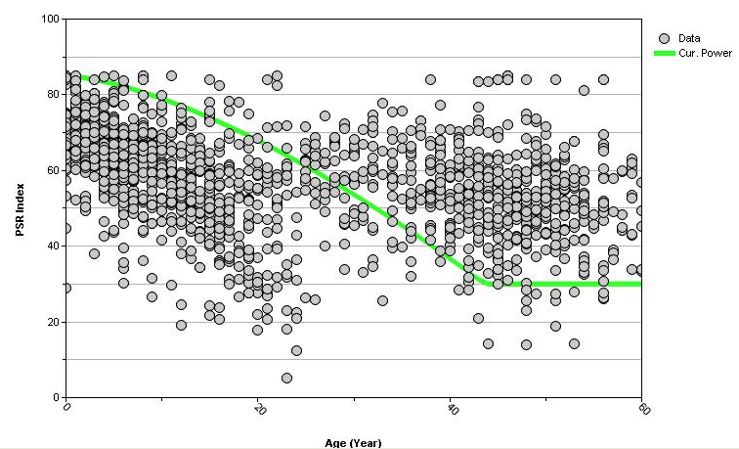
< 50 ESALs Granular Base PSR Index Model
Notes:
This demonstrates how critical it is to understand the maintenance and capturing their life cycle costs. What is critical with this chart is the years across the bottom; some of these measure points are 60 years since their last treatment! How do they get there? By good maintenance, but if you are not capturing what the maintenance is, you need to capture how much the life cycle (yearly budget) is being spent a year. That is what is making these roads last that long, and if you don’t document that cost, you can’t really tell the TAM what the life cycle cost is.

Slide 50
Maintenance QC/QA Data Collection Technician
Notes:
A way to measure the effectiveness of the maintenance work is through the maintenance quality programs. This is so you can also see the overall improvements to the system..

Slide 51
Current Construction Spending
Program
Bridge | 10%
Community Development | 3%
Environment | 1%
Maintenance | 6%
Mobility | 8%
Other | 1%
Pavement | 54%
Safety | 15%
Urban | 2%
Notes:
So these are the major expenses that Wyoming spends per year on the average. Capturing what maintenance does is critical for the TAMP but also for understanding of what value is being achieved.

Slide 52
Summary
The pieces are out there
Included in Long Range Transportation Plan
Included in pavement projection
Validated through Maintenance QA
We know they are critical for effective life cycle costs
Contract Costs
Maintenance work orders
Notes:
Asset management is out there, and is what we do. We need to document it and be transparent. We need to capture the costs, both through contract and work done by the maintenance forces of the state.

Slide 53
Questions?
Submit your questions using the webinar’s Q&A feature

Slide 54
Next webinar: Asset Management and Adaptation to Climate Change – November 13, 2013 2:00 EST

